Slide 1
sportsmanship
Teach acceptance of victory and defeat in a dignified and graceful manner; always treating participants with fairness courtesy and respect
Notes:
Introductions- Jan

Slide 2
SPORTSMANSHIP- BECAUSE IT MATTERS
The preeminent purpose of sports and activities is not to teach someone how to hit a three-pointer or to throw a curve ball but how to harness the discipline, desire and commitment that come from striving to achieve these goals and then channeling those traits into overcoming the challenges of everyday life. –
Robert F. Kanaby Former NFHS Executive Director
Notes:
Jan

Slide 3
Evidence shows that participation in high school athletic and fine arts activities can have a significant impact on the educational development and future success of students. Through extracurricular activities a student learns respect, teamwork, personal responsibility, integrity, honesty and leadership. The principles of sportsmanship and ethical behavior should be taught, modeled and enforced by:
PARENTS
EDUCATORS
SCHOOL ADMINISTRATORS
ATHLETIC DIRECTORS
COACHES
OFFICIALS
Notes:
Jan

Slide 4
Notes:
Jan - This is a great reminder to everyone of what we are trying to teach through sports participation.
This sign was posted outside an arena where students were participating.

Slide 5
UTAH HIGH SCHOOL ACTIVITIES ASSOCIATION CODE OF ETHICS THE CODE OF ETHICS IS AS FOLLOWS FOR STUDENT ATHLETES AND PARTICIPANTS:
Show cordial courtesy to opposing teams and officials.
Know the rules, abide by and respect the officials’ decision.
To achieve a thorough understanding and acceptance of the game and the standards of eligibility.
To encourage leadership, use of initiative and good judgement by participants through actions.
To recognize that the purpose of athletics is to promote the physical, mental, moral, social, and emotional well-being of the individual players.
To eliminate ALL taunting including racial slurs, discriminatory acts, and divisive comments on the basis of race, religion, gender, sexual orientation, creed or national origin.
To remember an athletic contest is only a game; not a matter of life-or-death for a player, coach or school.
Win with character; lose with dignity and respect.
Exercise self-control and reflect positively upon yourself, team and school.
Do not criticize officials or openly question the integrity of an official, especially in media outlets.
Notes:
Jan

Slide 6
Player/coach violation and minimum penalties
ACT
First ejection of player from a contest or scrimmage for unsportsmanlike conduct.
While serving his/her suspension and prior to returning to competition, an ejected player shall complete the free NFHS Course, “Sportsmanship” at nfhslearn.com
While serving his or her suspension and prior to coaching in his/her next contest, an ejected coach shall complete the NFHS online course, “Teaching and Modeling Behavior” (4-5 hrs, $20) at www.nfhslearn.com. If a coach or player is ejected during tournament play, they must have the required course completed before the next regularly scheduled contest or in the case of the state tournament, within one week of the ejection.
PENALTIES
Ineligible for the next regularly scheduled UHSAA contest at that level and any intervening levels of play. (Adopted Fall 2018)
The following is the definition of a contest by sport:
Baseball (7 innings) Basketball (4 Quarters)
Cross Country/Track & Field (Meet) Drill (Competition)
Football (4 Quarters) Golf (Match) Lacrosse (4 quarters)
Soccer (2 Halves) Softball (7 innings) Swimming (Meet)
Tennis (Match) Volleyball (Match) Wrestling (Match)
An overtime period(s) will not be included in determining the length of a suspension. In addition, contests ended by mercy-rule or early termination count as a contest.
Notes:
Brenan

Slide 7
Player/coach violation and minimum penalties
ACT
First ejection of coach from a contest or scrimmage for unsportsmanlike conduct.
Taunting, defined as including racial slurs, discriminatory acts, and divisive comments on the basis of race, religion, gender, sexual orientation, creed, or national origin.
Second ejection of a player or a coach from a contest during the same season of sport for unsportsmanlike conduct.
A third ejection of a player or a coach from a contest during the same season of a sport for unsportsmanlike conduct.
Coaches or players ejected for violent behavior.
PENALTIES
Ineligible for the next regularly scheduled contest at that level and any intervening levels of play. Player contest equivalents do not apply.
Ineligibility for the following number of regularly scheduled UHSAA contests at the level and any intervening levels of play. Players - 1st offense (2 contests), 2nd offense (4 contests) and 3rd offense (season and all other sports in the school year) Coaches - 1st offense (2 contests) and 2nd offense (suspension for season)
Ineligibility for the next two contests as in rule one for players and rule two for coaches.
Ineligibility for one calendar year (365 days) from the date of ejection.
Ineligibility for not fewer than two regularly scheduled contests. In addition, the incident shall be reported to the school or district, which may impose additional penalties consistent with the school’s disciplinary policies.
Notes:
Brenan

Slide 8
Parents and community
Notes:
Brenan- Parents can be one of the most challenging groups to deal with.
Here is an example of how not to do it.
How are you dealing with issues of parents demonstrating poor sportsmanship?

Slide 9
The UHSAA believes that all individuals should be treated with respect and dignity. Students should be able to participate in UHSAA-sponsored activities in an environment that is free from racial slurs, racial harassment, and racial discrimination.
THE UHSAA WILL NOT TOLERATE ANY FORM OF TAUNTING.
TAUNTING IS DEFINED AS ANY ACTION THAT IS INTENDED TO EMBARRASS, RIDICULE OR DEMEAN OTHERS UNDER ANY CIRCUMSTANCES INCLUDING ON THE BASIS OF RACE, RELIGION, GENDER, SEXUAL ORIENTATION, CREED OR NATIONAL ORIGIN.
THIS INCLUDES:
*STUDENT-ATHLETES *COACHES * PARENTS * FANS
Notes:
Jan

Slide 10
Fan/spectator policies and minimum penalties
ACT
Unsportsmanlike Conduct (Not Involving Taunting)
1st Ejection because of Taunting/Unsportsmanlike Behavior
2nd Ejection because of Taunting/unsportsmanlike Behavior
3rd Ejection because of Taunting/Unsportsmanlike behavior
PENALTIES
Game Administrator gives a Yellow Card to participant in question. The names of individuals who receive Yellow Cards will be tracked by the school to ensure on-going compliance. An individual’s record will be expunged if they complete the NFHS Sportsmanship Course.
Three-game suspension from UHSAA activities. The ejected party must complete the NFHS Sportsmanship Clinic and meet with their school principal before reinstatement. Taunting/racist language do not require a yellow card warning before ejection from the facility.
Ejection for the remainder of the sports season (all UHSAA activities).
Ban for one calendar year from UHSAA activities.
Notes:
Jan

Slide 11
YELLOW CARD PROTOCOL
THE YELLOW CARD WILL BE GIVEN BY A GAME ADMINISTRATOR WHO NOTES A FAN THAT IS BREAKING PROTOCOL BUT ISN’T ENGAGING IN ACTS OF TAUNTING. THE ADMINISTRATOR IS RESPONSIBLE TO TRACK THE NAME OF THE INDIVIDUAL RECEIVING THE CARD AND IS RESPONSIBLE TO NOTIFY THEM THAT IF THEIR BEHAVIOR CONTINUES, SCHOOL ADMINISTRATORS/LAW ENFORCEMENT WILL REMOVE THEM FROM THE FACILITY. THE PENALTIES IN ACT 1 WILL BE ENFORCED AS PART OF THE PROTOCOL.
Notes:
Jan

Slide 12
RED CARD PROTOCOL
THE RED CARD WILL BE GIVEN TO FANS WHO RECEIVE THEIR SECOND WARNING FROM A GAME ADMINISTRATOR DUE TO UNSPORSMANLIKE BEHAVIOR OR TO FANS WHO ENGAGE IN ACTS OF TAUNTING. FANS WHO RECEIVE A RED CARD WILL BE ASKED TO LEAVE THE FACILITY IMMEDIATELY. SCHOOL ADMINISTRATORS WILL BE RESPONSIBLE FOR TRACKING OF INDIVIDUALS WHO RECEIVE RED CARDS AND ENFORCEMENT OF THEIR BEHAVIOR EXPECTATIONS AS PART OF THE PROTOCOL.
Notes:
Jan

Slide 13
WHILE EACH PARTICIPANT IN UHSAA ACTIVITIES IS RESPONSIBLE FOR PLAYING A ROLE IN CREATING A SAFE, EDUCATIONAL EXPERIENCE, THE SCHOOL PRINCIPAL AND ADMINISTRATORS ARE ULTIMATELY RESPONSIBLE FOR THE CONDUCT OF GROUPS ASSOCIATED WITH THEIR SCHOOL COMMUNITY DURING THE REGULAR SEASON AND POST-SEASON. IT SHALL BE THE RESPONSIBILITY OF EACH MEMBER SCHOOL PRINCIPAL TO EXERCISE CONTROL OVER ALL INDIVIDUALS TO THE EXTENT NECESSARY TO ENSURE SAFETY AND FAIR PLAY FOR ALL PARTICIPATION AND ADHERENCE WITH THESE STANDARDS.
Notes:
Brenan

Slide 14
School administration responsibilities
Outline and post standards of sportsmanship. Include the behavioral criteria for each student group, spectator, school personnel, coaches, game staff, sponsors, etc. and standards of conduct expected of each.
Provide adequate game supervision. Make faculty aware that problems and potential problems must be reported and dealt with immediately. This may involve securing law enforcement.
Parents, players, students and fans must understand their roles and what is expected of them.
Employ athletic coaches who have a sound understanding of their role and are primarily concerned with the accomplishment of educational objectives.
Notes:
Brenan

Slide 15
Athletic directors’ responsibilities
Provide enough staff and security supervision for spectator control.
Provide opportunities for informing students and adult spectators of the rules and penalties for all sports and activities.
Use a competent public address announcer who will promote the fundamentals of sportsmanship.
Work closely with the cheerleaders and sponsors in techniques of crowd management.
Enlist and encourage the support of student groups in the implementation of crowd management.
Have regular staff and coaches' meetings to inform, review and enforce sportsmanship policies.
Make sure all support groups conduct themselves in accordance with the sportsmanship theme. Specifically, behaviors such as bands playing during a game, unauthorized cheers, taunting or encouraging negative chants.
Notes:
Brenan

Slide 16
Athletic directors’ responsibilities
Monitor and provide direction for each event as it relates to crowd control.
Use scorekeepers and timers, trained adults, who can do the job competently, remain under control and exhibit no bias.
Assign a responsible adult to greet the visiting team and officials and show them to their dressing room.
Faculty members should be assigned to oversee the conduct of fans, cheerleaders, pep squads, bands, etc. They should be visible and attend away games as well as home games.
Uniformed law enforcement officers should be on duty for all games.
During team introductions the principals and/or athletic directors of the competing schools could be introduced, meet at center court, shake hands and go sit with respective student bodies.
Notes:
Brenan

Slide 17
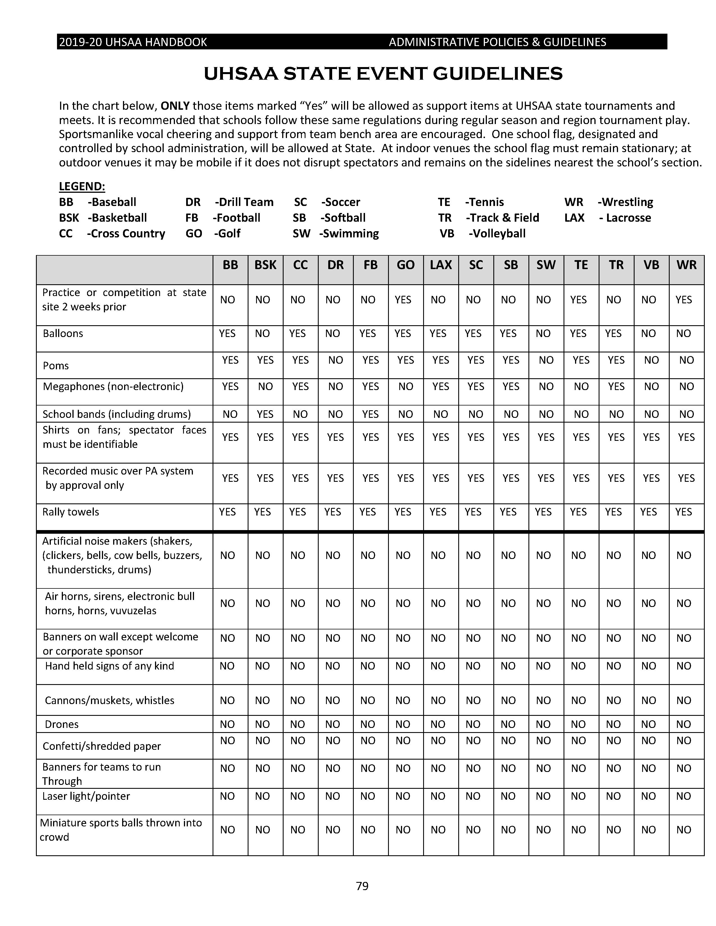

Slide 18
Uhsaa sportsmanship initiatives
Dare 2 Lead Student Leadership Conference
Raise the Bar- School Sportsmanship Award
Zero Ejections Award/Banner
Sportsmanship Video Scholarship
Notes:
Jan

Slide 19
Register my coach
Concussion Protocol ( Yearly)
Sexual Abuse Training (Yearly)
Bullying, Hazing/Harassment Training (Yearly)
Background Check (District Policy)
First Aide Training (District Policy)
CPR (District Policy) Recommended Hands on Component for CPR.
Fundamentals on Coaching Course (Once Time Course)
Professional Ethic Standards as describe in USBE Rule R277-515.
NFHSLEARN.Com
Notes:
Brenan

Slide 20
working together with a common purpose we can make extraordinary things happen!
Notes:
Brenan

